Slide 1
ESQC 2024
Mathematical Methods Lecture 5
By Simen Kvaal

Slide 2
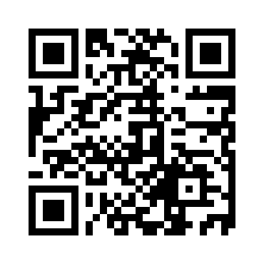
Where to find the material
SCAN ME
Alternative 1:
www.esqc.org, go to“lectures”
Find links there
Alternative 2:
Scan QR code
simenkva.github.io/esqc_material

Slide 3
Complex analysis

Slide 4
Why complex analysis?
Wavefunction is complex !
Time-dependent Schrödinger equation
Wave phenomena
Response theory: poles of response function
Evaluation of integrals – analytic continuation
Perturbation theory of eigenvalues
Application to analysis of real functions
Complex notation simplifies (!)

Slide 5
Complex plane topology
Domain with hole – not simply connected
The complex plane is topologically the same as ℝ²
Simply connected domain – open, no holes

Slide 7

Visualization using color wheel
Color the complex numbers according to angle and modulus

Slide 8
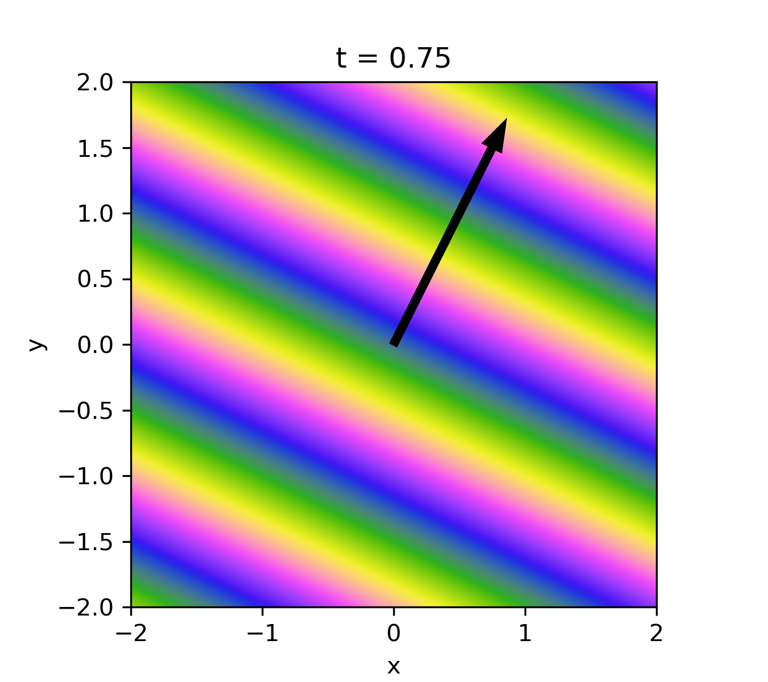
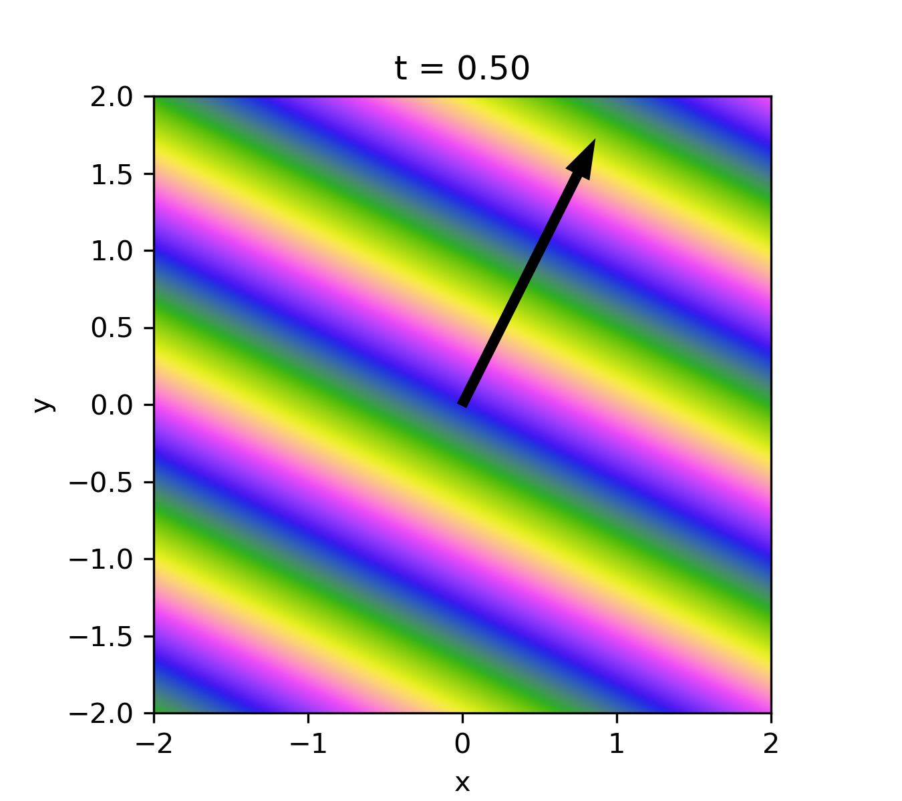
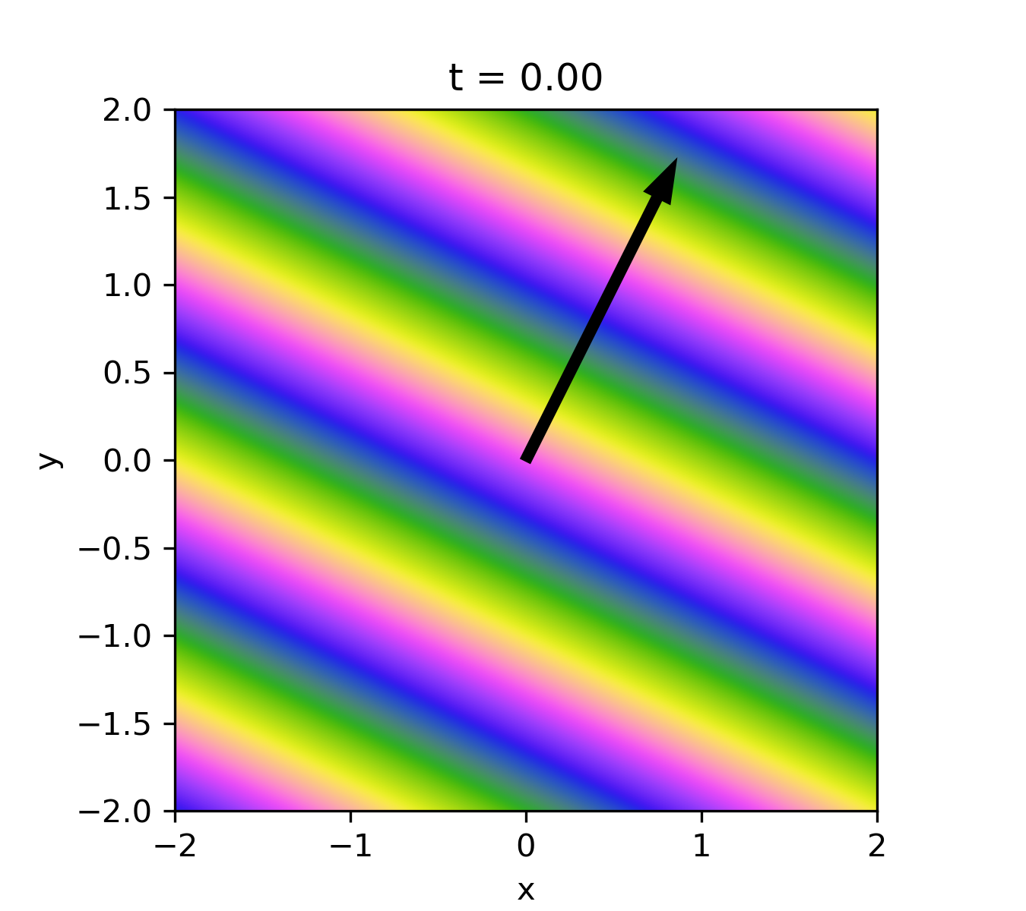
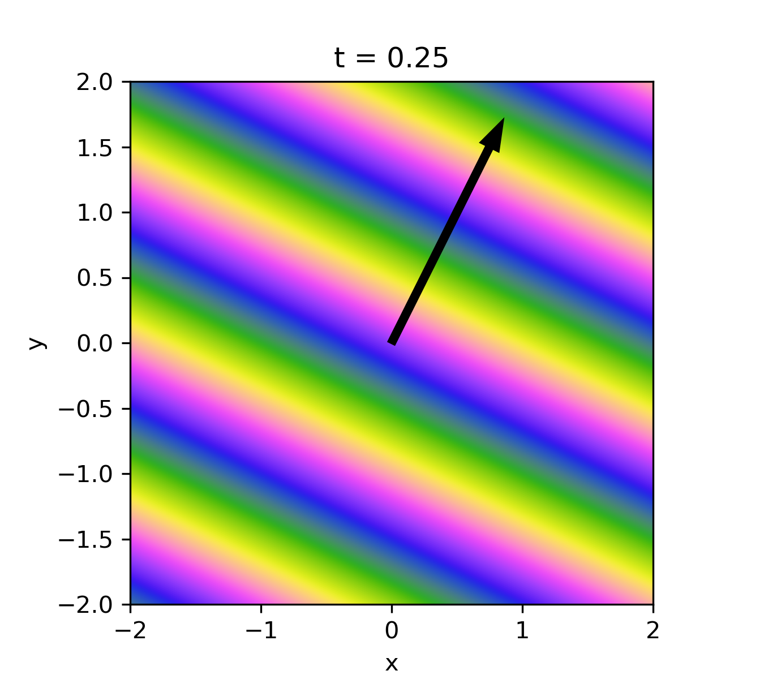
Example: Plane wave in 2d

Slide 9
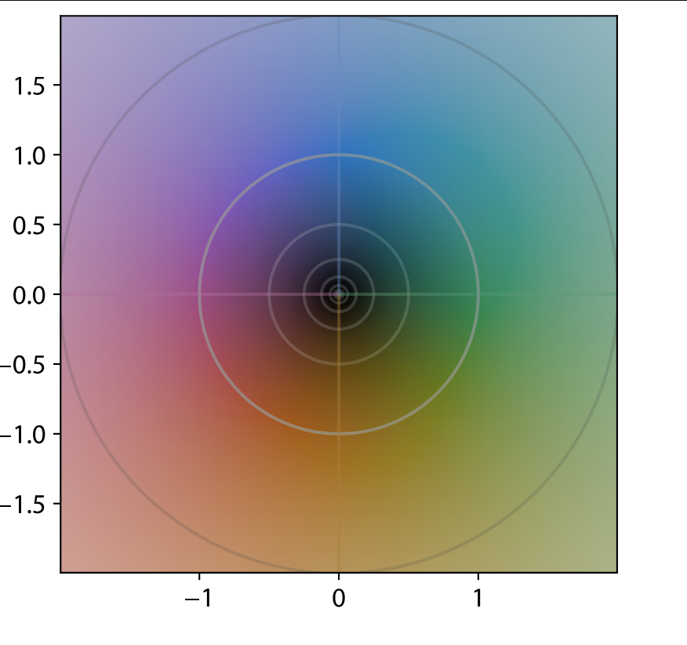
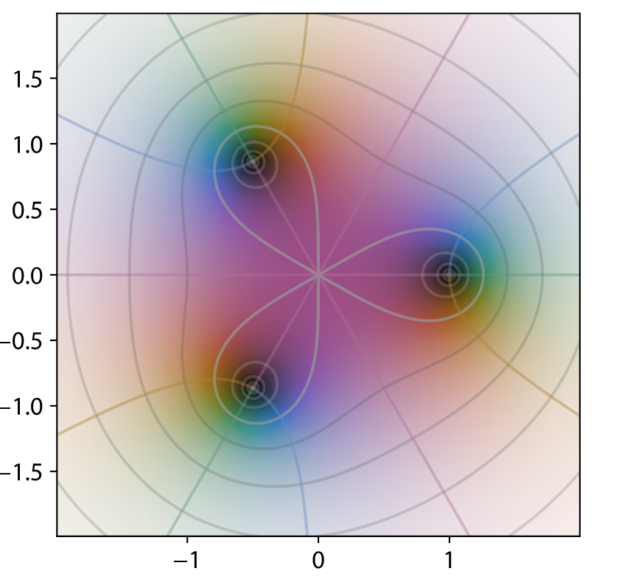
Example from https://en.wikipedia.org/wiki/Domain_coloring

Slide 10
The idea of a pure function
Which functions f(z) are “pure functions of complex z”?
“Pure” become infinitely differentiable!
Beautiful and useful theorems on their behavior
Not ”pure” 🙁

Slide 11
holomorphic
💡
The definition is the same as in one-variable calculus,
BUT h can approach 0 in more ways!

Slide 12
Cauchy—Riemann equations
A complex function f : ℂ → ℂ can be viewed as a function f : ℝ²→ℝ²
Consequence of complex differentiability:
Strongly restricts complex differentiable functions!

Slide 13
Notice how algebra is used, no limits needed

Slide 14
Re z is not complex differentiable either

Slide 15
The concept of a series is very important in general

Slide 16
Holomorphic functions
Given
If f is complex differentiable at all
We say that f is holomorphic
Cauchy-Riemann implies:
f is infinitely many times differentiable
Etymology:
• Holo-: from the Greek word holos, meaning “whole” or “entire.”
• -morphic: from the Greek word morphē, meaning “form” or “shape.”
Notes:
So, holomorphic roughly translates to “having the entire form” or “completely formed,” which relates to the idea that holomorphic functions behave very smoothly and predictably across their domain.

Slide 17
Isolated singularities
Suppose f is holomorphic in a punctured disc (z₀ not in set)
We say that f has an isolated singularity
Three options:
Removable singularity:
f can be extended to the hole
Pole of order p:
f cannot be extended,
Essential singularity:
f cannot be extended, does not behave like a pole

Slide 18
Holomorphic functions are analytic
Small error
Recall that if f is differentiable
But holomorphic means infinitely differentiable
Remarkably, we have a convergent power series
There is always a (possible infinitely large) disc where the series converges
Infinite series, no error!

Slide 19
So functions can be defined as power series!

Slide 20
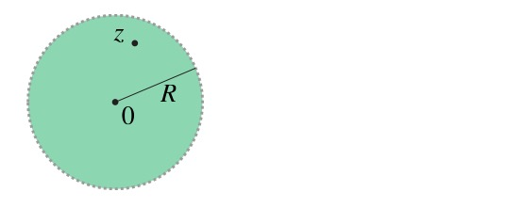
The origin could be any complex number, and not only zero

Slide 21
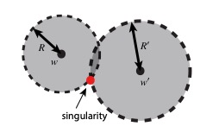
Convergence radius when starting from different points
In general, one can develop power series around different points, converging to the same function
But the convergence radius can be different
Radius is determined by closest singularity, e.g., pole

Slide 22
Laurent series
No error!
We can develop power series near a pole!
Example:
Laurent expansion around pole at z=0

Slide 23
Removable singularity
This function is defined everywhere except z = 0:
By the usual rules for differentiation, it is holomorphic
We Taylor expand around the origin and find:
So we can define f(0) = 1 and we remove the singularity!

Slide 24
Complex line integrals

Slide 25
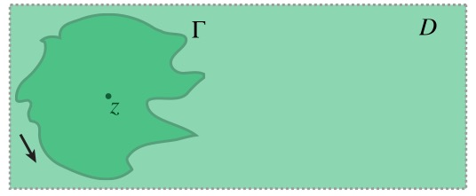

Slide 26
The value of the function depends only on the value on the curve!

Slide 28
Cauchy residue theorem
Recall Laurent:
Definition of residue at singularity:
Residue theorem: If f holomorphic in U₀
Sum over holes inside curve

Slide 29
Example: Evaluation of integral
Task: compute:
Use residue theorem on
Find Laurent expansion around i
Res(f,i) = 1/(2i)
Integral over semicircle is small, only integral on [-R,R] left
Take limit as R to infinity

Slide 30
Fourier series and transform

Slide 31
What is Fourier theory good for?
Some partial differential equations become simpler
Poisson equation ...
Plane-wave basis sets
Solid state systems, crystals ...
Response theory
How a quantum system responds to periodic perturbations (e.g., EM waves)
Signal processing, image analysis

Slide 32
Epicycles of planetary motion
Ptolemaic and Copernican system of astronomy was geocentric
But observations required epicycles
An early form of Fourier series

Slide 33
Epicycles of planetary motion
Ptolemaic and Copernican system of astronomy was geocentric
But observations required epicycles
An early form of Fourier series
(The ancient Greeks did not use complex numbers)

Slide 34
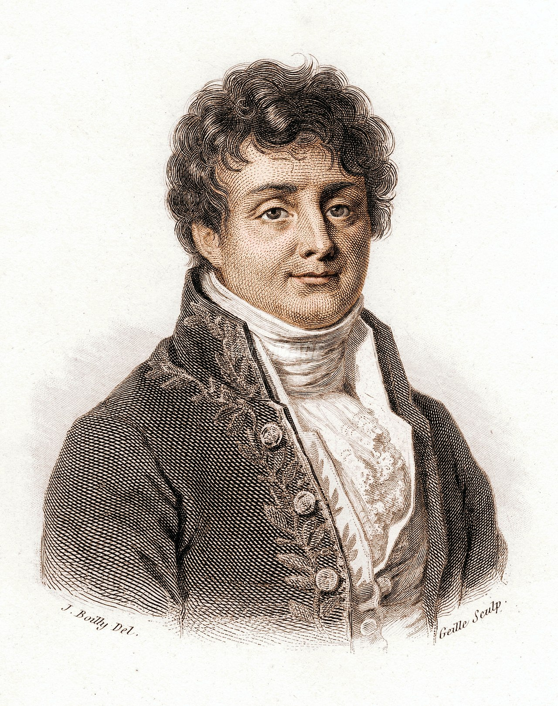
Joseph Fourier (1768-1830)
Had the idea that general periodic functions could be decomposed into sinusoidal components
A function of period T:

Slide 35
Complex Fourier series
The exponential functions are periodic, shorter and shorter period
Let
The function is periodic with period T if
Consider now a Fourier series
Assuming convergence of series, clearly a periodic function
Can we find a series such that
?

Slide 36
Theorem: Complex Fourier series
Let
Periodic with period T
Square integrable in [0,T] :
Let and
Then “almost everywhere”

Slide 37
In terms of infinite dimensional Hilbert
The exponential functions are orthonormal basis functions for L²[0,T]
Fourier series ”just” a basis expansion!
But an L² function only defined up to “sets of zero length”, so convergence not necessarily everywhere

Slide 38
Examples
We watch a Jupyter notebook with Fourier series of
Square wave
Sawtooth wave
...

Slide 39
Dirichlet conditions
Conditions on f such that Fourier series converges everywhere
Must be periodic
A finite number of maxima and minima in one period
A finite number of discontinuities
Under these conditions, the series converges everywhere
Except at discontinuities, where it converges to average of ”jump”
See, e.g., square wave example

Slide 40
Sine/cosine series
Using Euler’s formula:
We rewrite the Fourier series:
Equivalent series, but sine/cosine can be more useful sometimes

Slide 41
Fourier transform
For functions that are not periodic:
The (normalized) Fourier transform is defined as:
Fact: The transform is a unitary transformation on

Slide 42
Inverse Fourier transform
Sign in exponent only difference
Since transform is unitary, it must have an inverse:
What a beautiful symmetry!

Slide 43
Examples
Jupyter notebook

Slide 44
Generalization to higher dimensions
Normalized Fourier transform and inverse:
Again, a unitary transformation

Slide 45
Duality of differentiation and multiplication
Consider the very informal manipulation:
Suggests, and indeed so:
True in Sobolev space

Slide 46
Duality of smoothness and falloff
Suppose we can differentiate f a number of times:
Since Fourier transform is unitary we must have
Not entirely rigorous statement ...

Slide 47
Example: Filtering an image
A Jupyter notebook showing high-pass and low-pass filtering using Fast Fourier Transform (FFT)

Slide 48

Last slide
Thanks for joining the journey!
Make sure to check out the maps, literature and YouTube recs:
https://simenkva.github.io/esqc_material/

